Slide 1

Group 06:
19127597 – Trần Khả Trí
19127607 – Trần Nguyên Trung
19127426 – Vũ Đức Quang Huy
19127491 – Nguyễn Trọng Nhân
19127057 – Trần Vĩnh Phát

Slide 2
Introduction
Problem statement
The problem of | Current music applications: soundcloud, spotify, youtube...
Affects | Students and officers
The impact of which is | - The user experience is not really good - In some cases, interrupting the user's ideas, affecting work performance
A successful solution would be | We create a software that supports the function of taking notes while listening to music, interacting with people directly

Slide 3
Introduction
Product Position Statement
For | everyone over 6 years old, especially students and officers
Who | love listening to music and working in a music environment
The (product name) | Sportifry
That | allows users to listen to music easily, and can take notes on work or an idea right on the software without switching tabs, people can also interact with each other via chat function
Unlike | Current apps are not friendly to the working model combined with entertainment.
Our product | satisfy the needs of young users, create inspiration while working, increase the ability to interact and exchange between people

Slide 4
Introduction
User
Name | Description | Responsibilities | Stakeholder
Admin | Who work with software system | Supporting and interacting with customer, administration. Troubleshooting for users, artists | Developer and tester
Artists | who post songs, and manage their products | composing their songs, responsible for copyright | moderators and musicians
Member | who can use app with full functions | enjoy music, express feelings about products, contribute ideas to develop products | Team lead, registered users as members
Guest | who can listen to music, chat | Not allow to use todolist, playlist | unregistered users

Slide 5
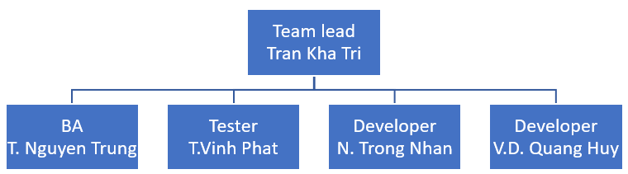
Project management
Team structure

Slide 6
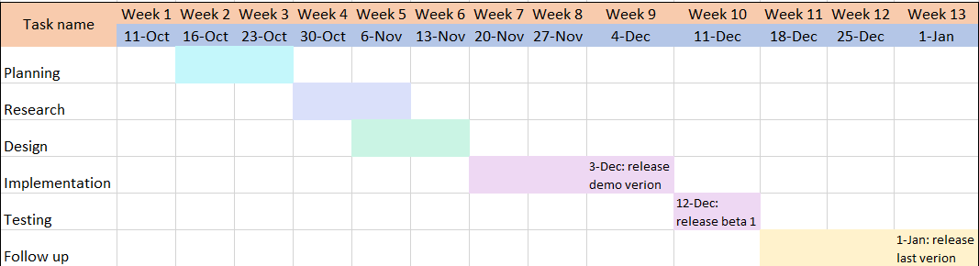
Project management
Time line

Slide 7
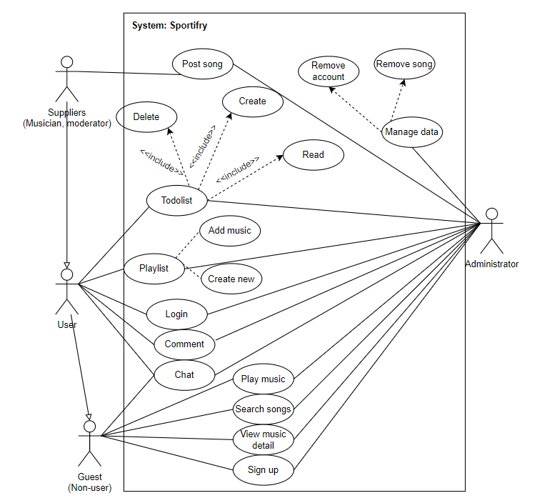
Use case
Use-case Model:

Slide 8
Vision
Non-Functional Requirements:
Sound quality
Vivid sound quality, giving listeners a complete and distraction-free experience.
Poor quality songs will be completely replaced with the latest and high quality songs.
Websites interface
The website's interface is eye-catching, with soft colors that make it comfortable to look at. At the same time, the songs are intelligently arranged to help listeners easily approach and relax.
Websites access speed
Fast access speed, rarely stops while listening to music
Database
The listener's information is stored securely and intelligently. The songs are also stored in the way the team chooses for the fastest retrieval

Slide 9
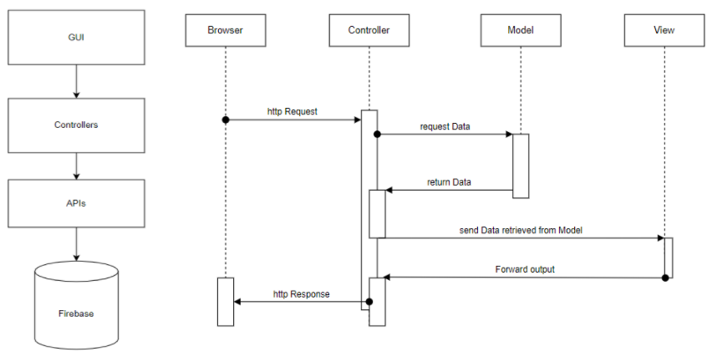
Software architecture
Logical View:

Slide 10
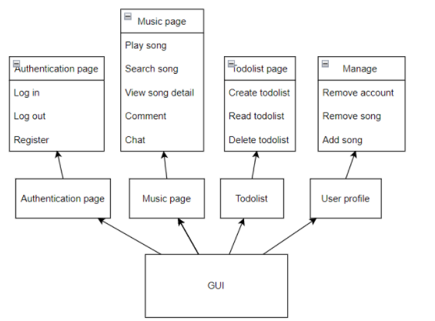
Software architecture
Component: GUI

Slide 11
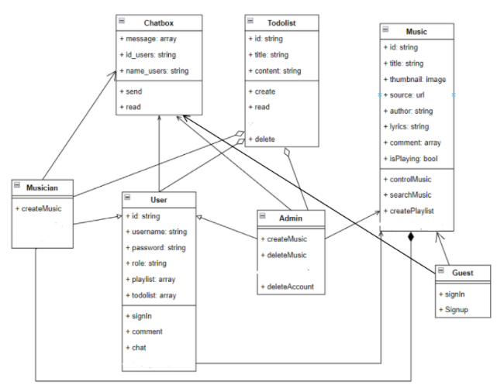
Software architecture
Component: Model + Controller

Slide 12
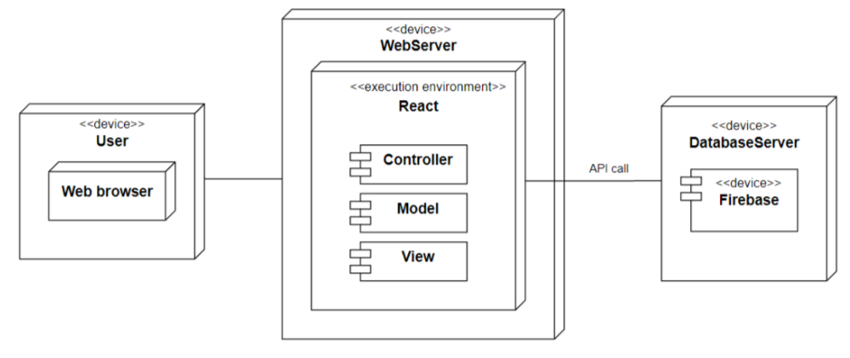
Software architecture
Deployment

Slide 13
Test plan
Target Test Items:
- Functional testing.
- UI testing.
Environmental Needs:
Device requirements:
+ Any device has an operating system that can run Node JS.
+ Stable internet connection (LAN, WIFI, 4G,...)
Tool auto testing:
Katalon Studio
Chromium
Chrome
Windows 10

Slide 14
Test plan
Responsibilities, Staffing and Training Needs
- People and roles
Tester: 4
Test manager: 1
List scheduling plan test of team:
Name | Role | Features
Nguyen Trong Nhan | Test manager | UC15, UC16
Vu Duc Quang Huy | Tester | UC5, UC6
Tran Nguyen Trung | Tester | UC4, UC14, UC17, UC18
Tran Kha Tri | Tester | UC1, UC2, UC3, UC8
Tran Vinh Phat | Tester | UC9, UC10, UC11, UC12, UC13

Slide 15
Test plan
ID | Feature
UC01 | Login as admin, musician
UC02 | Login as user
UC03 | Sign up
UC04 | Search music for all user
UC05 | Create todolist
UC06 | Read todolist
UC7
UC08 | Remove todolist
UC09 | Chat box
UC010 | Remove song (for admin)
UC11 | Remove account (for admin)
UC12 | Add song (for admin)
UC13 | Add account (for admin)
UC14 | Comment
UC15 | Logout
UC16 | Play music
UC17 | Add a playlist
UC18 | Delete a playlist

Slide 16
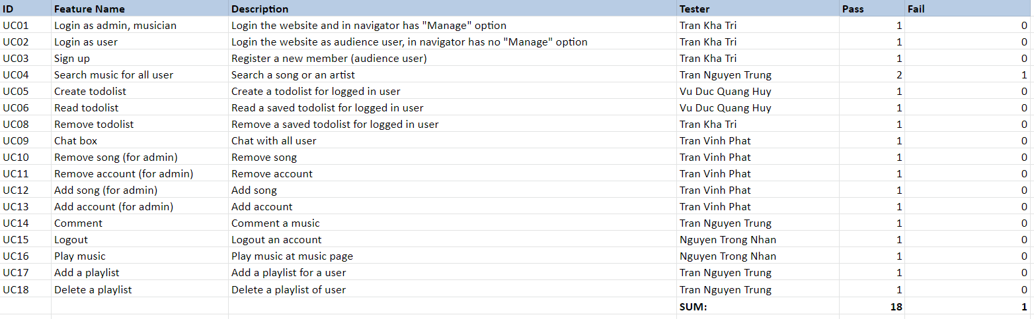
Test cases & Test report

Slide 17
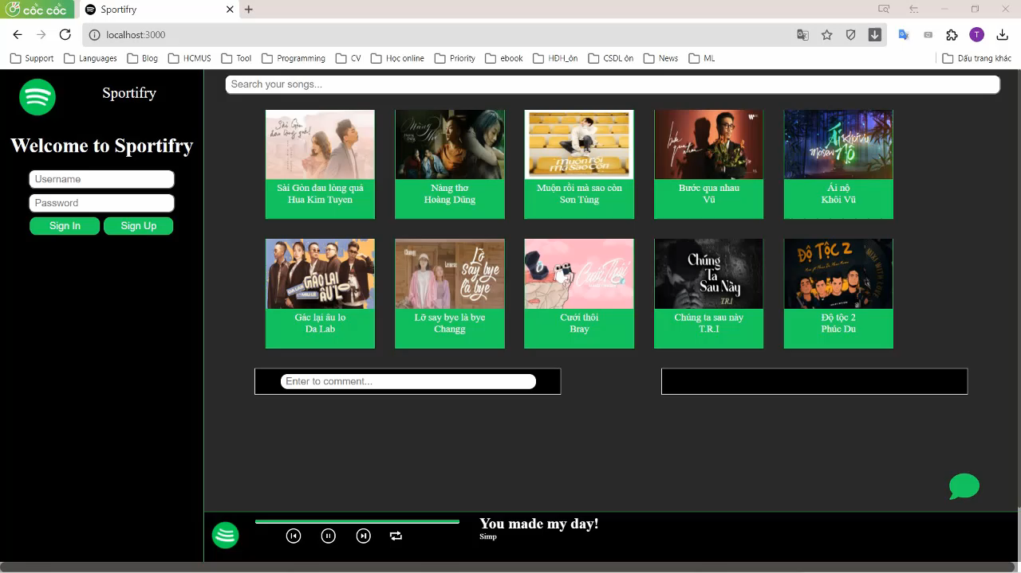
Demo project

Slide 18
Thank you for watching our presentation

